Slide 1
INVESTMENT CASE STUDY SUBMISSION
Group Name:
Vijayanand Narayanan
Jayanti Tripathi
Shriram Venkat Peddhibhotla
Devesh Joshi

Slide 2
Abstract
Business Brief
Identify investment opportunities for Spark Funds to invest in a few global companies
Only choose English speaking countries for investments
Invest between 5 to 15 Million USD per round of investment
Objectives
Carry out analysis of Global Investment trends using data from crunchbase.com. Understand where other investors are investing and recommend investment opportunities by,
Identifying suitable investment type
Identifying best countries
Identifying best sectors

Slide 3
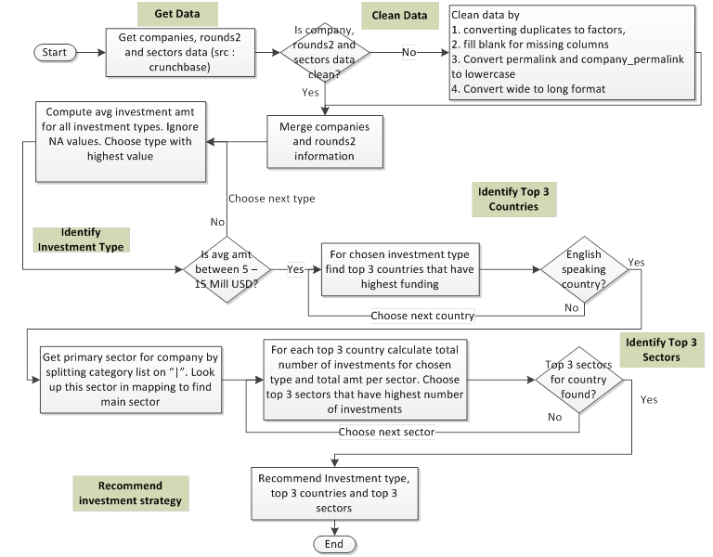
Problem Solving Methodology

Slide 4
Investment Type Analysis
Nearly 60% of all global investments have been in Venture investment type and making it popular amongst investors
Venture attracted the highest amount of all investment types from global investors across all sectors
Average amount raised by venture is within Spark Funds investment range of 5 to 15 Million USD
Private Equity raised the highest average amount of 73 Million but it is not within Spark Funds investment range of 5 to 15 Million USD
Venture investment type had 50,228 investments and making it the highest number of investments from investors across the globe
Venture investment is best suited for Spark Funds

Slide 5
Country Analysis
USA raised the most amount of investments across all sectors for venture investment type
China was actually second best in terms of raising most amount of investments. But, it is not an English speaking country and hence not suitable for investment
Great Britain becomes the second best English speaking country that raised most amount of investments
India is the third best English speaking country for investments
Canada raised lower than India but is also an English speaking country
Top 3 investment friendly countries are USA, GBR and IND

Slide 6
Sector Analysis
Top 3 sectors for investment in USA are “Others”, ”Cleantech...Semiconductors” and “Social..Finance..Analytics..Advertising”
Top 3 sectors for investment in GBR are “Others”, ”Cleantech...Semiconductors” and “Social..Finance..Analytics..Advertising”
Top 3 sectors for investment in IND are “Others”, “News..Search.and.Messaging” and “Social..Finance..Analytics..Advertising” or “Entertainment”
Sectors “Social..Finance..Analytics..Advertising” and “Entertainment” in IND raised the same number of investments (32)
Sector “Others” is the most popular in all the 3 countries USA, GBR and IND and has attracted most amount of investments

Slide 7
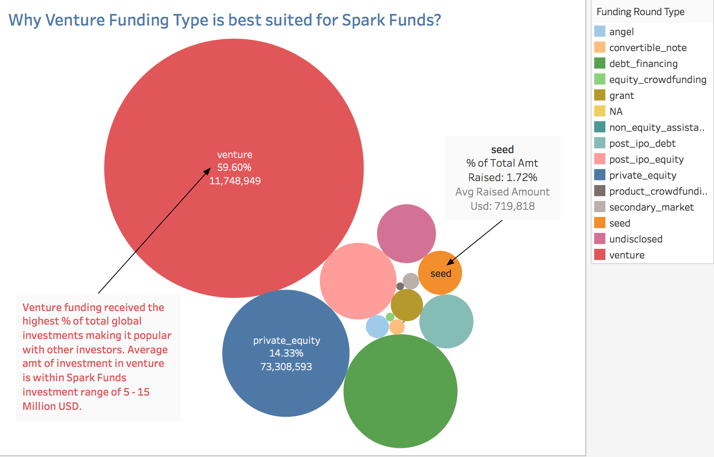
Funding Type Results

Slide 8
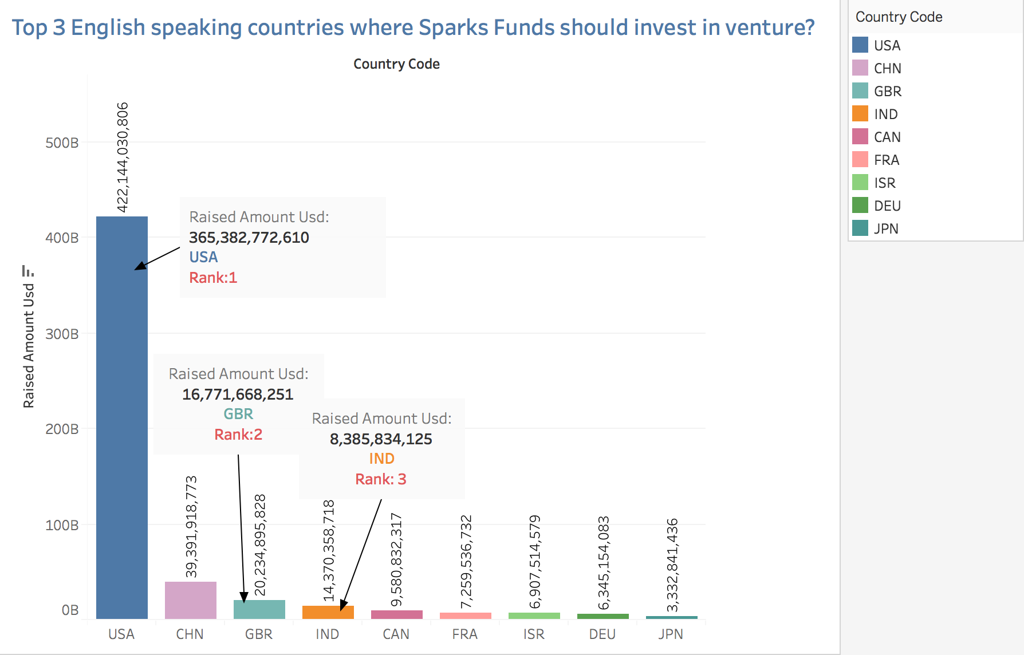
Country Results

Slide 9
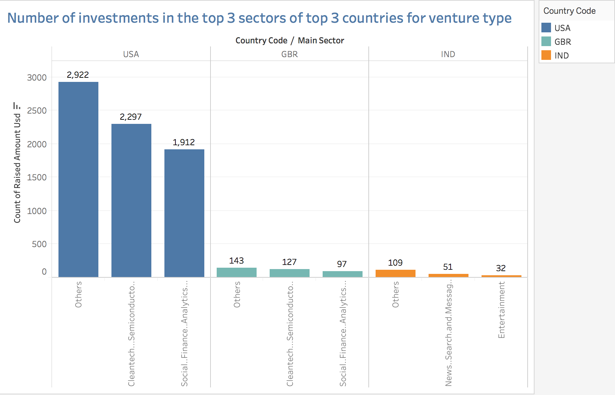
Sector Analysis

Slide 10
Conclusions
Global trends in investment has been understood by carrying out in-depth analysis of various investment types, countries that received the highest funding and the sectors that attracted most investments.
Following conclusions have been reached,
Venture investment type is best suited for Spark Funds
Top 3 investment friendly English speaking countries are USA, GBR and IND
“Others” sector is best suited in USA, GBR and IND
Recommended Investment Strategy
Invest in Venture companies in USA/GBR/IND dealing in Others sector for maximum returns

